Slide 1
SQL Server 2012
Summary of New Features
Blatantly Plaguarised From MSSQLTips

Slide 2
Topics
New licensing model
Always On
Contained Database
Columnstore Index
FileTable
SQLLocalDB
Sequences
SSMS
SSDT
Programming Enhancements

Slide 3
New Licensing
Core based rather than processor based

Slide 4
Always On

Slide 5
Contained Database
A contained database basically includes all database settings and the metadata within itself thereby resulting in no configuration dependencies on the instance of the SQL Server Database Engine where the database is actually installed. Users will be able to connect to a contained database without authenticating a login at the Database Engine level.
This feature really helps to isolate the database from the Database Engine thereby making it possible to easily move the database from one instance of SQL Server to another. In this tip we will take a look at how to configure and use this feature of SQL Server 2012.
MSSQLTips

Slide 6
FileTable Feature
A FileTable is a new user table which gets created within a FILESTREAM enabled database. Using the FileTable feature, organizations can now store files and documents within a special table in SQL Server and they will have the ability to access those files and documents from windows. When you use this feature it will appear to you as if the files and documents are residing on a file system rather than in SQL Server. However, in order to use the FileTable feature you need to enable the FILESTREAM feature on the instance of SQL Server 2012.
MSSQLTips

Slide 7
SQL Server Express LocalDB
SQL Server Express LocalDB is a new lightweight edition of Express that has all its programmability features, yet runs in user mode and has a fast, zero-configuration installation and short list of pre-requisites. The LocalDB edition of SQL Server is targeted to program developers. LocalDB installation copies a minimal set of files necessary to start the SQL Server Database Engine. Once LocalDB is installed, developers initiate a connection by using a special connection string. When connecting, the necessary infrastructure is automatically created and started, enabling the application to use the database without complex or time consuming configuration tasks. Developer Tools can provide developers with a SQL Server Database Engine that lets them write and test Transact-SQL code without having to manage a full server instance of SQL Server. An instance of SQL Server Express LocalDB can be managed by using the SqlLocalDB.exe utility.
MSDN

Slide 8
Sequences
The following are the main points about the CREATE SEQUENCE statement:
Specify the schema where you want to create the sequence
Specify the name of the sequence
The sequence type can be any of the built-in integer types; e.g. tinyint, smallint, int, bigint, decimal or numeric; decimal or numeric require a scale of 0
The sequence type can also be a user-defined type that is based on one of the built-in integer types
The default sequence type is INT
Use START WITH <integer constant> to specify the first sequence number to be assigned; this can be a negative number
INCREMENT BY <integer constant> determines the next value assigned by the sequence number; this can be a positive or negative value but not 0
MINVALUE <integer constant> and MAXVALUE <integer constant> provide the bounds for the sequence number; the default for MINVALUE is 0 for a tinyint and the smallest negative number for the type of the sequence number; the default for MAXVALUE is the maximum value for the type of the sequence number
Specify CYCLE to restart the sequence number at the MINVALUE after the MAXVALUE is reached
Specify NO CYCLE to throw an exception after the MAXVALUE is reached rather than restarting with the MINVALUE
Use CACHE <integer constant> to retrieve a sequential block of sequence numbers
MSSQLTips

Slide 9
SSMS
Based upon Visual Studio 2010
Support for snippets
Improved keyboard shortcuts
Tasklist

Slide 10
SQL Server Data Tools (SSDT)
Replaces the Database Project in Visual Studio
Exposes additional SSMS functionality (effectively the SSMS Object Explorer)
No Schema view (hooray) for database projects
Much improved table designer, based upon SSMS, but with additional features. No need to run SSMS as a code developer
Uses SQLLocalDB for it’s datastore
2 and 4 are available in existing VS solutions without use of the new SSDT project type

Slide 11

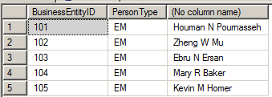
New Data Windowing Functions
OFFSET
Equivalent of LINQ Skip(n) extension method
FETCH
Equivalent of LINQ Take(n) extension method
MSSQLTips

Slide 12

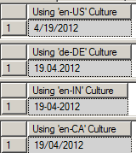
Formatting Functions (1)
FORMAT
The FORMAT function returns a returns a value formatted with the specified format and optional culture as shown in the below query result. Much like String.Format in .NET
MSSQLTips

Slide 13
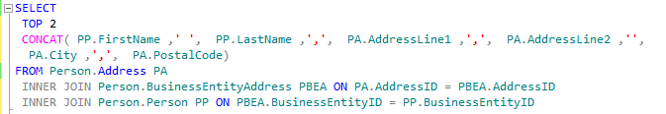

Formatting Functions (2)
CONCAT
Returns a string that is the result of concatenating two or more string values. The CONCAT function implicitly coverts all arguments to string types and then concatenates the inputs. The CONCAT function requires a minimum of two input values else the concatenation fails.

Slide 14
New DateTime Functions
DATEFROMPARTS
TIMEFROMPARTS
DATETIMEFROMPARTS
DATETIME2FROMPARTS
SMALLDATETIMEFROMPARTS
DATETIMEOFFSETFROMPARTS
EOMONTH
MSSQLTips

Slide 15
THROW
At present using a TRY/CATCH block to handle an error situation, and then re-raising the error using RAISEERROR throws away the error details returning instead details of the catch clause
THROW re-raises an error preserving the original error infor4mation
MSSQLTips

Slide 16
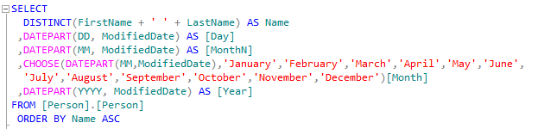
New Logical Functions (1)
CHOOSE
The CHOOSE function, which is available in SQL Server 2012, will return the item at the specified index from the list of values which are available. In this example we have 3 values and we are asking to select the third value in the list which is "SQL Server 2012".
MSSQLTips

Slide 17
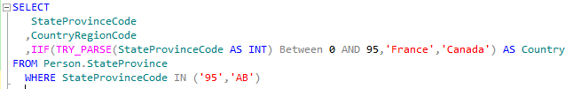
New Logical Functions (2)
IIF
The IIF function, which is available in SQL Server 2012, returns one of the two values depending upon whether the Boolean expression evaluates to either True or False.
MSSQLTips

Slide 18
FirstValue, LastValue
These new functions allow you to get the same value for the first row and the last row for all records in a result set.
MSSQLTips

Slide 19
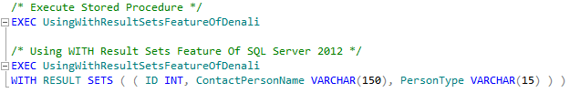

WITH RESULTS SET
There was always a limitation in the previous versions of SQL Server that whenever you wanted to change a Column Name or a Data Type within the result set of a Stored Procedure you ended up making changes to all the references within a Stored Procedure. This limitation has been overcome with the release of WITH RESULT SETS feature in SQL Server 2012.
MSSQLTips

Slide 20
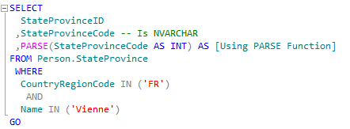
Data Type Conversions (1)
PARSE
The PARSE function which is available in SQL Server 2012 can be used to convert any string value to a Numeric or to a Date and Time format. However, SQL Server 2012 will return an Error if it cannot convert a passed value to Numeric or to a Date and Time format. It is important to note the PARSE function relies on the presence of the .NET Framework Common Language Runtime (CLR).
MSSQLTips

Slide 21
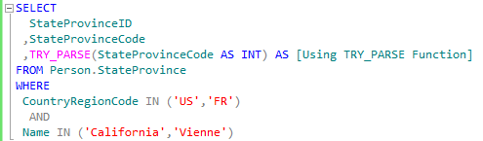

Data Type Conversions (2)
TRY_PARSE
The TRY_PARSE function which is available in SQL Server 2012 can be used to convert any string value to a Numeric or to a Date and Time format. However, if SQL Server 2012 cannot convert a passed value to Numeric or to a Date and Time format, then it will return a NULL value rather than failing the entire TSQL code.

Slide 22
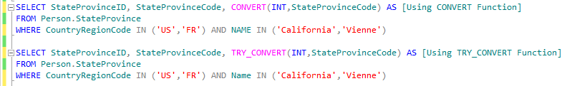

Data Type Conversions (3)
TRY_CONVERT
The TRY_CONVERT function which is available in SQL Server 2012 takes the values passed to it and tries to convert it to a specified Data Type. If the conversion is successful then it will return the value as the specified data type. Otherwise it will return a NULL value. However if you request a conversion that is explicitly not permitted, then the TRY_CONVERT fails with an error.

Slide 23

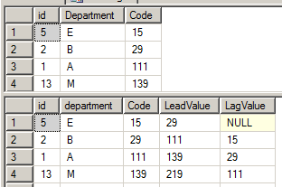
Lead and Lag
These functions access data from a subsequent row (lead) and previous row (lag) in the same result set without the use of a self-join.
MSSQLTips

Slide 24
New Spatial Features
MSDN

